Slide 1
CSC 439 Sprint Week 1
Jacob Moore, Zack Sprague, Craig James, Chris Wells, Joshua McGuire, Reed Inderwiesche

Slide 2
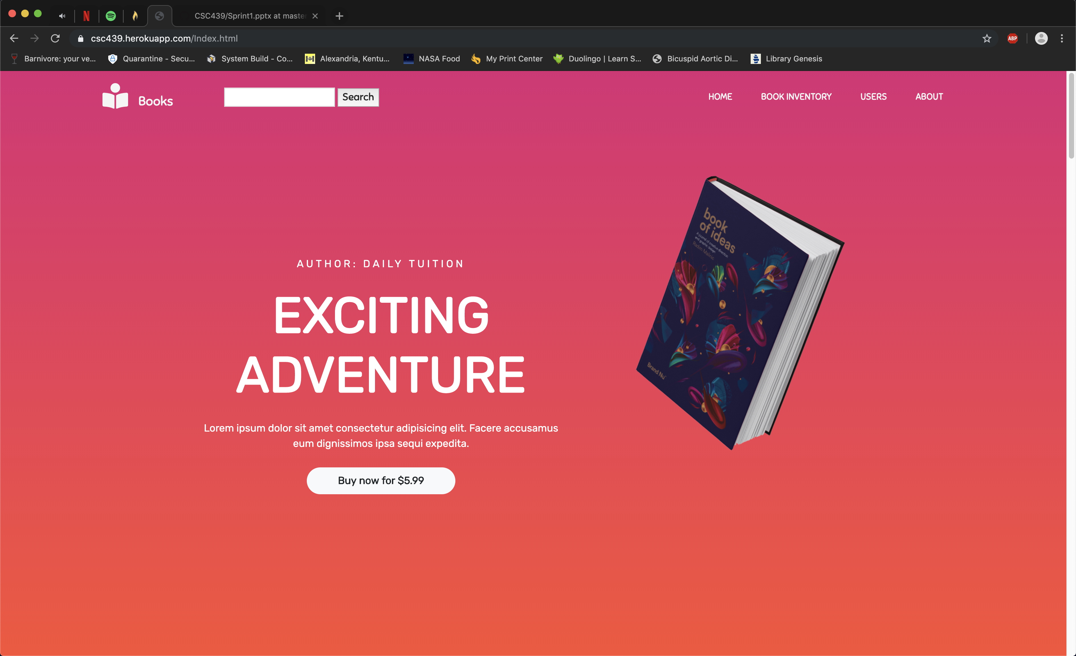

Book Inventory Website
^ Desktop
^Mobile

Slide 3
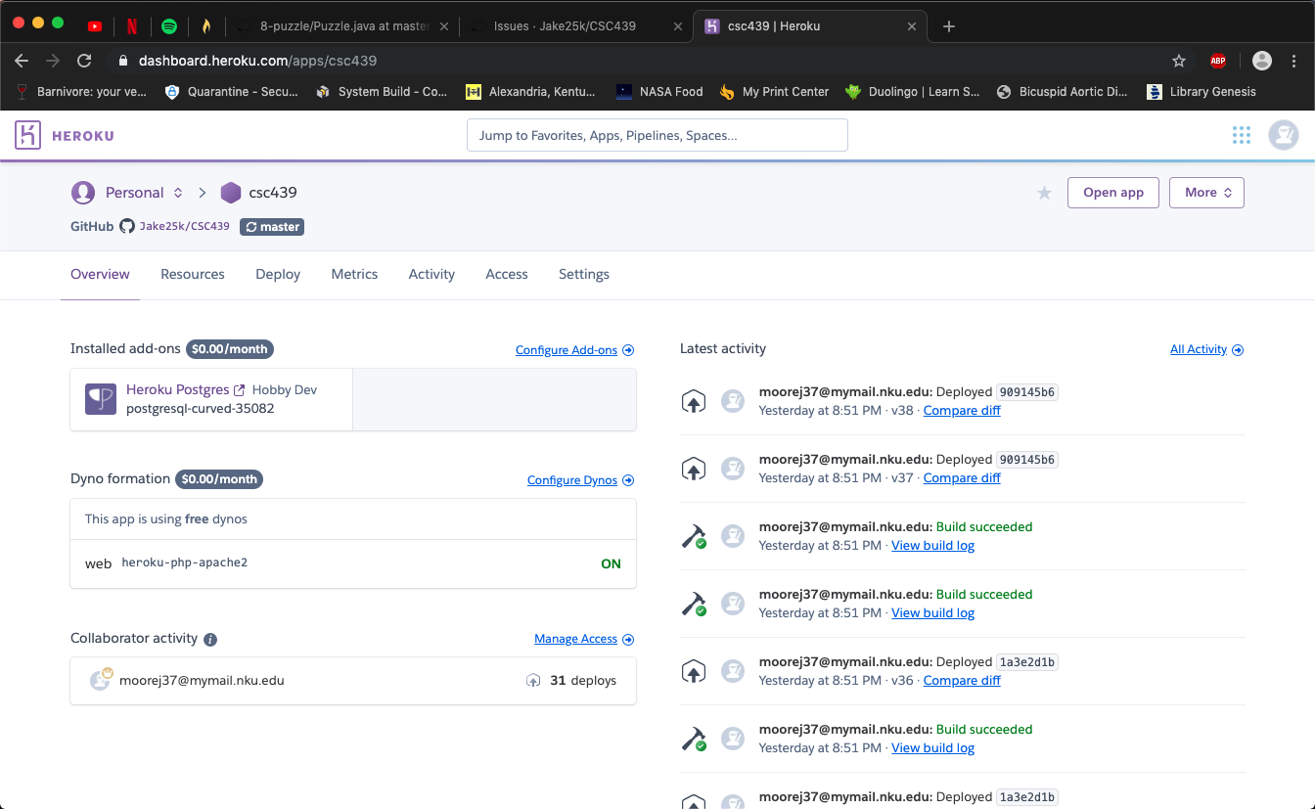
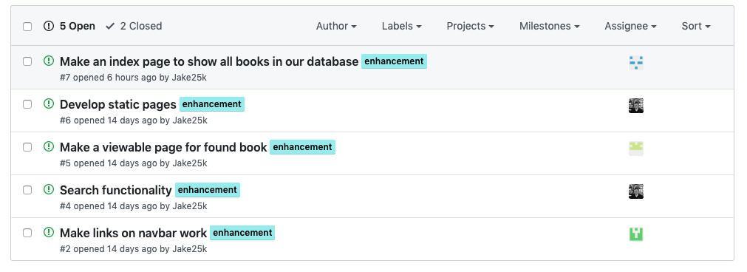
Team Lead/Developer: Jacob Moore
Task: 1. Set up webserver to host our website (Heroku) 2. Integrate a database using PHP (Set up in Heroku) 3. Delegate activities for team to complete this week
(Using Github)
^Web server interface
<< Tasks to be delegated

Slide 4

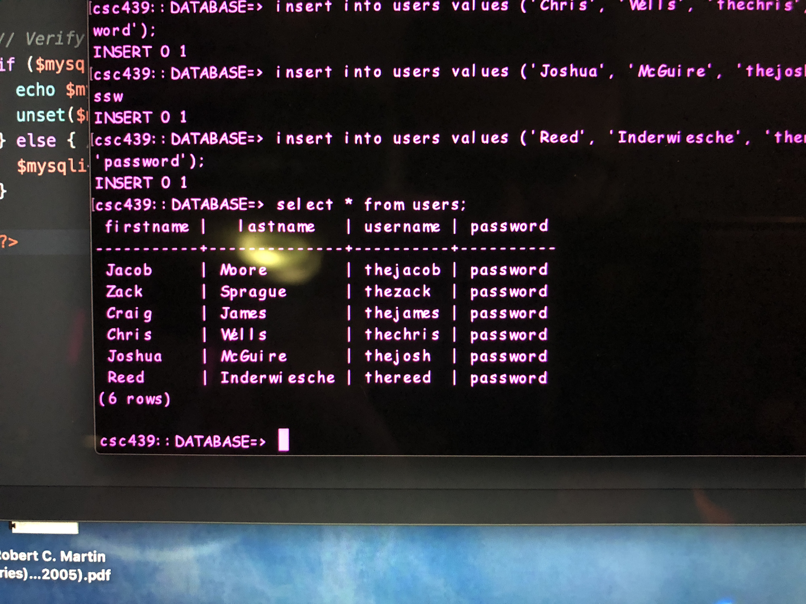
Tester/Developer: Zack Sprague
Generates a list of our users
from the database
Task: Implemented users in database

Slide 5
Tester/Developer: James Craig
When we first started, a lot of the links on the navigation bar were not working.
My goal for this sprint was to get the navigation bar operational.
For this sprint, we had to:
Create the pages that we are going to use for the navigation (My task)
Link them to the navigation bar (My task)
Add the code to make them work (Chris’s Task)
Possible goal for next sprint is to figure out how to get the navbar to work for mobile devices.

Slide 6
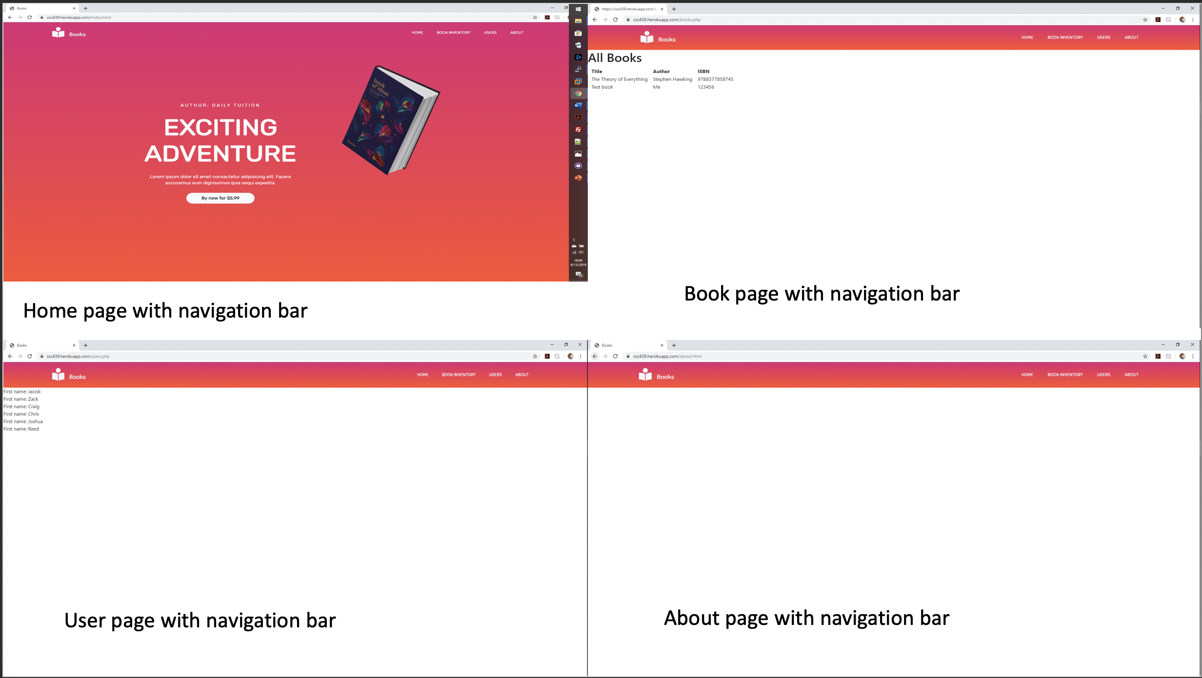
Tester/Developer: James Craig
When we first started, the links were not working.
The goal for this sprint was to get the navigation bar operational.
For this sprint, we had to create the pages that we are going to use for the navigation.
Then add the code to make them work.
Possible goal for next sprint is to figure out how to get the navbar to work for mobile devices.

Slide 7

SCM Manager/Developer: Chris Wells
Task 1: Develop static pages (The pages our navigation bar links to)

Slide 8
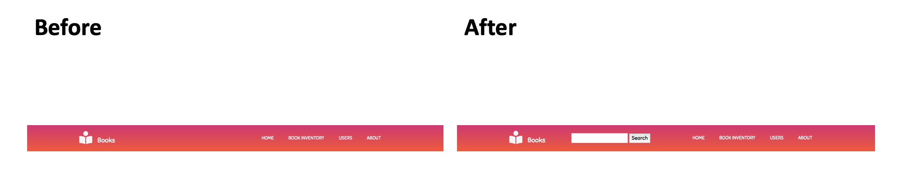

SCM Manager/Developer: Chris Wells
Task 2: Search functionality using PHP and SQL

Slide 9
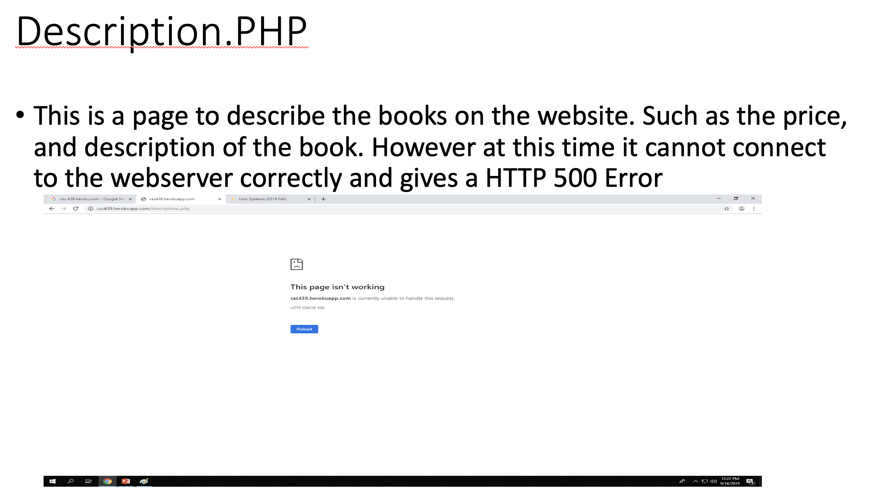
Configuration Manager/Developer: Josh McGuire

Slide 10
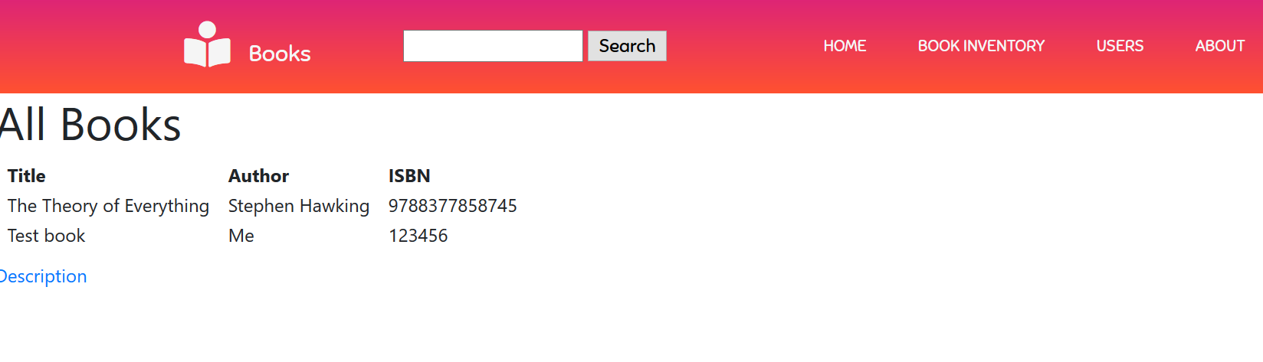
Build Manager Reed Inderwiesche
Assisted in initial setup of PostgreSQL database to work with the Heroku deployment
Added a book inventory page, which lists all the books in the database all on one page.
Books have a title, author, and ISBN number

